Slide 1
CENTRE for INDUSTRY
EDUCATION COLLABORATION
Sustainable fuel:
Main beam

Slide 2
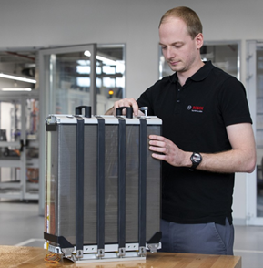
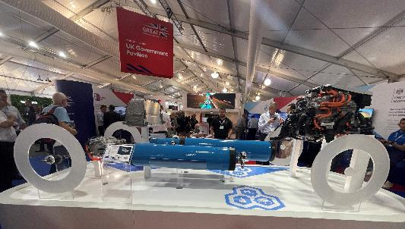
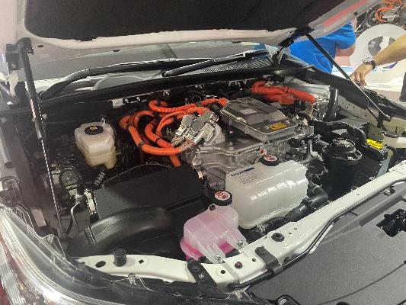
Fuel cells
fuel cells stacked together
model of fuel cells and hydrogen storage in a vehicle
fuel cells stack inside a vehicle
hydrogen
fuel cell stack
fuel cells

Slide 3
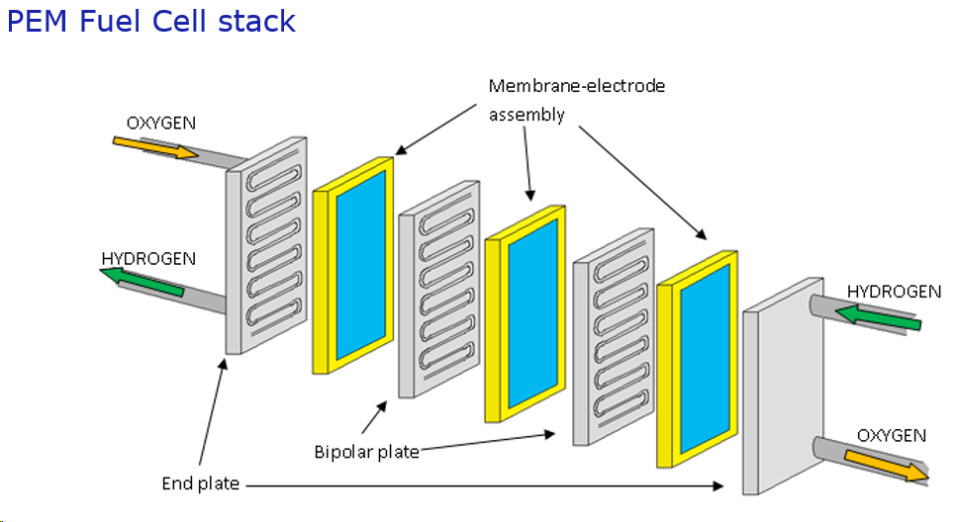
A hydrogen fuel cell
and catalyst
Separating plate

Slide 4

www.ciec.org.uk

